Slide 1
OBJECT ORIENTED PROGRAMMING WITH C++
CSE2001
Virtual Arduino Project
By: Exception Handlers

Slide 2
Members
Kimaya Holkar :-24BAI10815
Abigail Zachariah :-24BCE10010
Daksh Jain :-24BCE10620
Arya Sankar :-24BCE10895
Jaya Mewada :-24BCE11442

Slide 3
Individual Roles
Kimaya Holkar : PPT and concept explanation .
Abigail Zachariah : PPT
Arya Sankar : Circuit and its explanation
Daksh Jain : Project code and explanation
Jaya Mewada : Video concept and editing

Slide 4
This project simulates a traffic light system integrated with pedestrian control using Arduino, all within a virtual environment (e.g., Tinkercad). It allows users to experiment with hardware and coding without using a physical Arduino board. The simulation models real-world behavior by using LEDs to represent traffic and pedestrian lights and a button to request a pedestrian crossing.
Virtual Arduino Project – Pedestrian Traffic Light Simulation

Slide 5
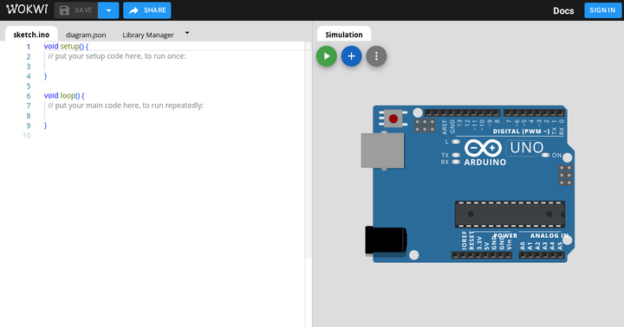
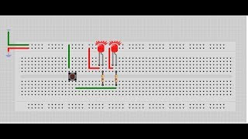
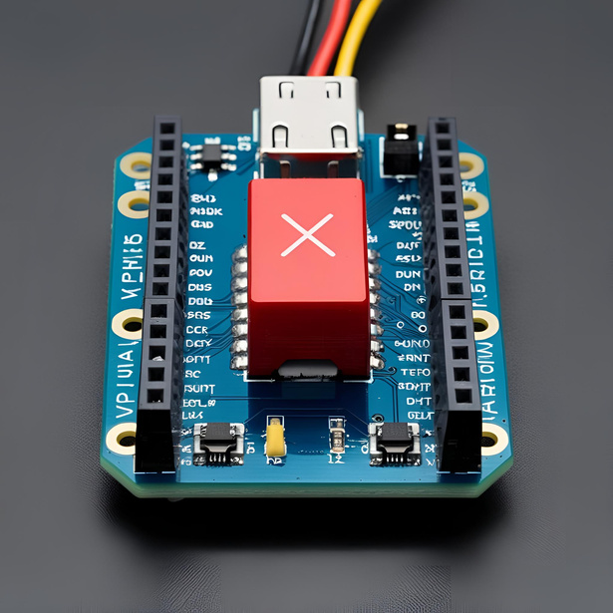
Components Used(Virtually):
Arduino Uno board
LEDs: Red, Yellow, Green (for both traffic and pedestrian)
Breadboard
Push button (pedestrian crossing request)
Resistors and jumper wire

Slide 6
How It Works:
System starts with normal traffic flow (green light for vehicles).
When pedestrian presses the button:
Traffic light changes to yellow, then red.
Pedestrian light turns green, allowing safe crossing.
After a delay, system resets to traffic green and pedestrian red.
Timing control ensures realistic signal durations.

Slide 7
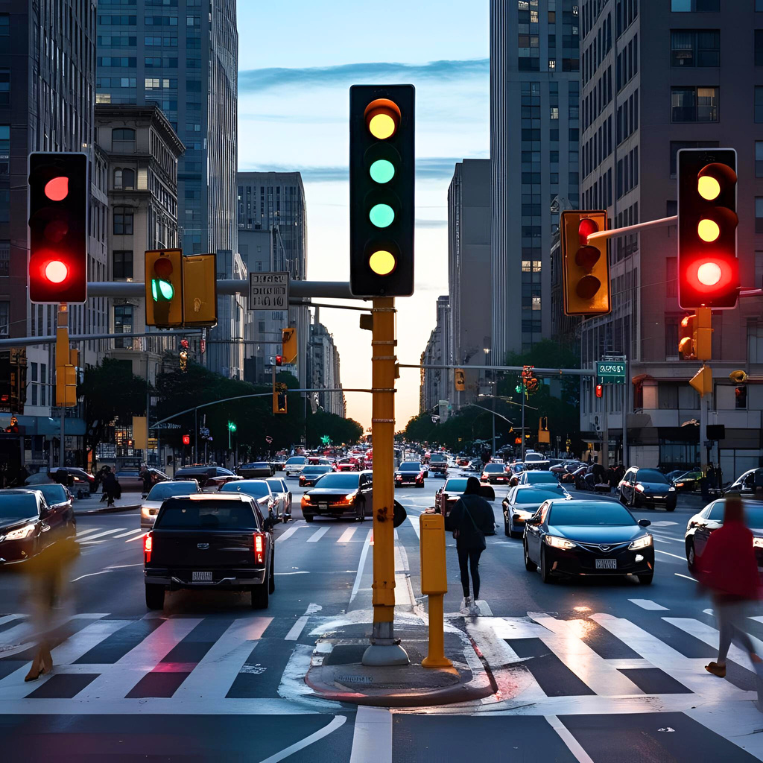
Features
1.States: Red, yellow, and green light sequences for each direction.
2.Programmable Timers: The Arduino allows for setting the duration of each light color via code, enabling customization of traffic flow.
3. LEDs: Uses LEDs to visually represent the traffic light colours.
4. Pedestrian Signals: Implement pedestrian signals (e.g., flashing "walk" or "don't walk" symbols).

Slide 8
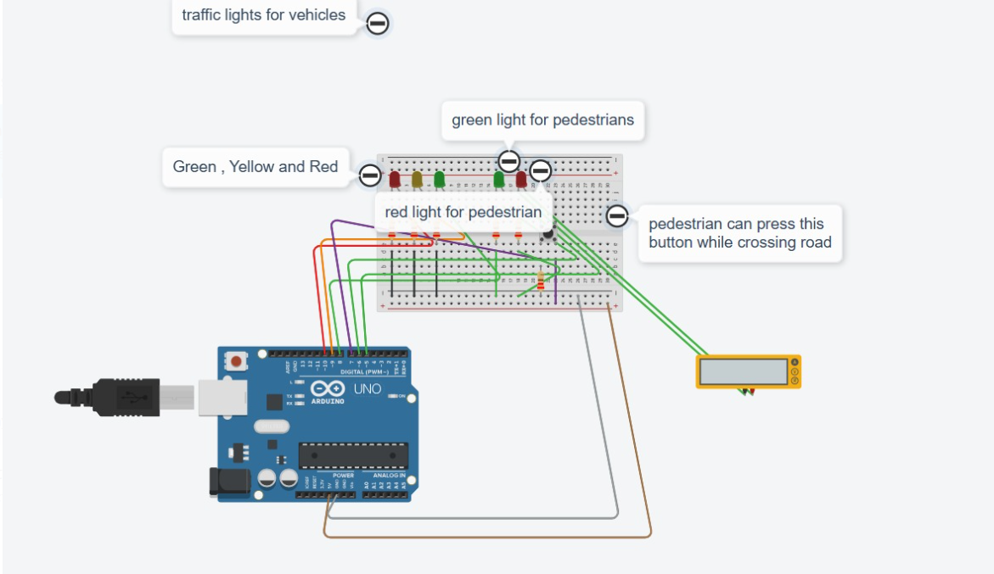
Single traffic signal with pedestrian

Slide 9
C++ CODE
// Pin Assignments
const int trafficRed = 10;
const int trafficYellow = 9;
const int trafficGreen = 8;
const int pedGreen = 6;
const int pedRed = 5;
const int buttonPin = 7;
// Timing (milliseconds)
const int yellowTime = 2000;
const int walkTime = 5000;
const int resetTime = 1000;
bool pedestrianRequest = false;
void setup() {
pinMode(trafficRed, OUTPUT);
pinMode(trafficYellow, OUTPUT);
pinMode(trafficGreen, OUTPUT);
pinMode(pedGreen, OUTPUT);
pinMode(pedRed, OUTPUT);
pinMode(buttonPin, INPUT_PULLUP);
// Start with default state
digitalWrite(trafficRed, LOW);
digitalWrite(trafficYellow, LOW);
digitalWrite(trafficGreen, HIGH);
digitalWrite(pedRed, HIGH);
digitalWrite(pedGreen, LOW);
}
void loop() {
// Check button press
if (digitalRead(buttonPin) == LOW) {
delay(50); // Debounce
if (digitalRead(buttonPin) == LOW) {
pedestrianRequest = true;
// Wait for release
while (digitalRead(buttonPin) == LOW);
}
}
if (pedestrianRequest) {
// Transition: Green OFF → Yellow ON
digitalWrite(trafficGreen, LOW);
digitalWrite(trafficYellow, HIGH);
delay(yellowTime);
// Yellow OFF → Red ON
digitalWrite(trafficYellow, LOW);
digitalWrite(trafficRed, HIGH);
// Pedestrian: Red OFF → Green ON
digitalWrite(pedRed, LOW);
digitalWrite(pedGreen, HIGH);
delay(walkTime);
// Pedestrian: Green OFF → Red ON
digitalWrite(pedGreen, LOW);
digitalWrite(pedRed, HIGH);
delay(resetTime);
// Traffic: Red OFF → Green ON
digitalWrite(trafficRed, LOW);
digitalWrite(trafficGreen, HIGH);
pedestrianRequest = false; // Reset
}
delay(100);
}

Slide 10




digitalRead() to detect button press
digitalWrite() to control LEDs
Code Highlights:
Use of delays for timing transitions
Button debounce handling
Logic control with if and while
statements

Slide 11


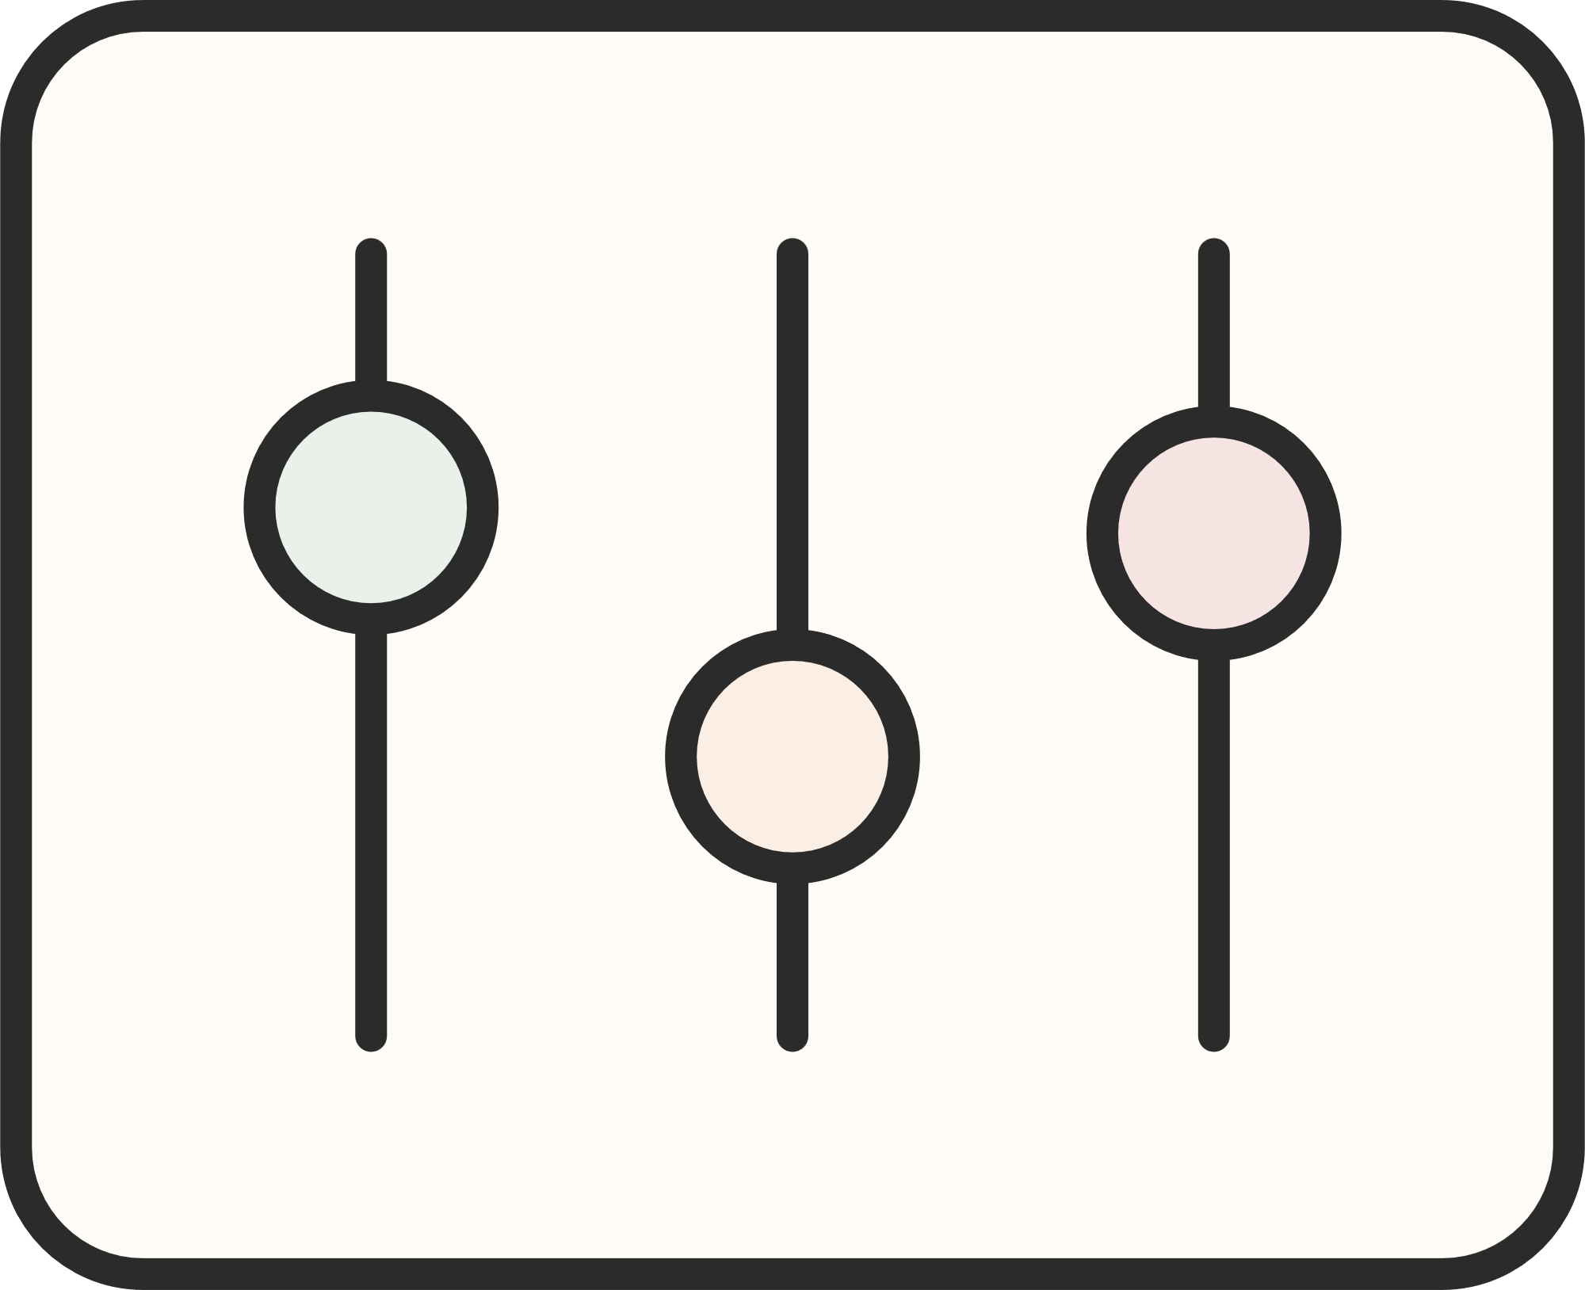





No physical Hardware needed
Great for beginners to practice Arduino logic
Advantages:
Mimics real world traffic system behaviour
Safe, cost effective learning platform

Slide 12
Thank you!

